Slide 1

Advanced x86: BIOS and System Management Mode Internals Memory Map
Xeno Kovah && Corey Kallenberg
LegbaCore, LLC

Slide 2
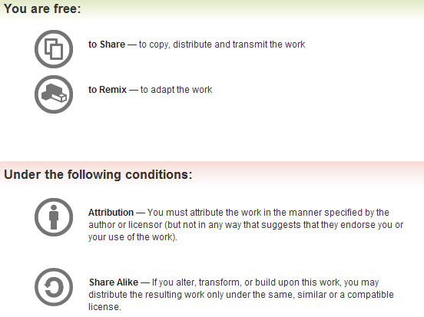
All materials are licensed under a Creative Commons “Share Alike” license.
http://creativecommons.org/licenses/by-sa/3.0/
Attribution condition: You must indicate that derivative work
"Is derived from John Butterworth & Xeno Kovah’s ’Advanced Intel x86: BIOS and SMM’ class posted at http://opensecuritytraining.info/IntroBIOS.html”
Notes:
Attribution condition: You must indicate that derivative work
"Is derived from John Butterworth & Xeno Kovah’s ’Advanced Intel x86: BIOS and SMM’ class posted at http://opensecuritytraining.info/IntroBIOS.html”

Slide 3
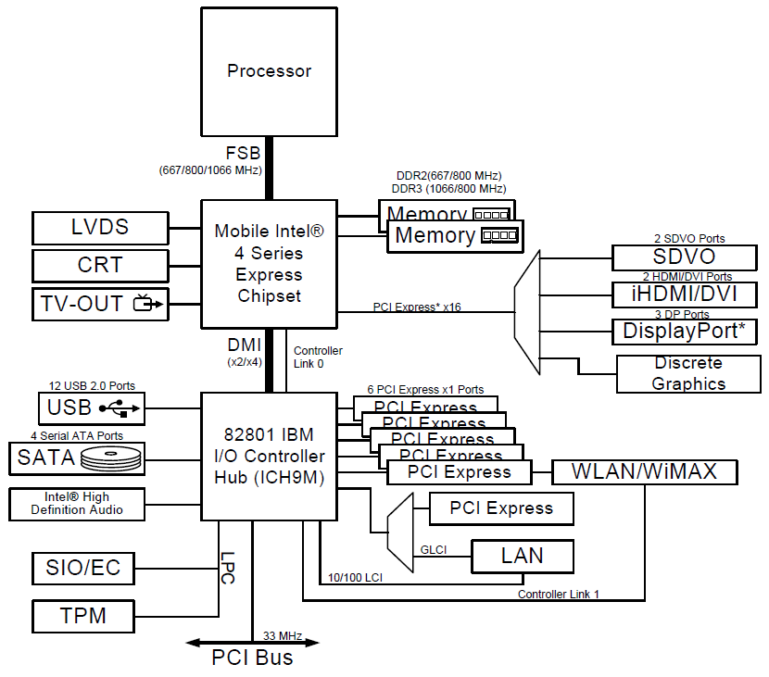
Memory Map
One of the primary responsibilities of the BIOS is to program the memory map
Many devices, in order to be useful, require their interfaces be extended to memory
Also this is how the BIOS can ensure information about the way it set up the system is passed to the operating system at the time of handoff

Slide 4
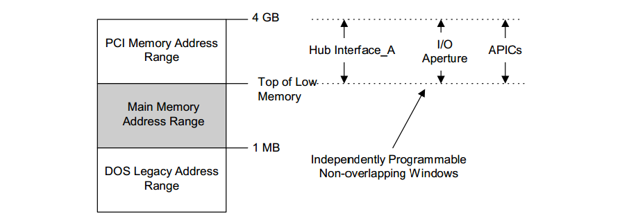
4 “Basic” Ranges in System Memory
TOUUD
TOM
TOLUD
High Memory Range: Memory above 4GB (called Top of Upper Usable DRAM). Used for memory mapping and recoverable memory (system memory that overlaps with the PCI range)
TOM (Top of Upper Memory): size of physical memory
PCI Memory Address Range: Used for memory-mapped IO (TPM, APIC, Flash, PCI Express, devices on chipset, etc.)
Main Memory Address Range: Addressable memory from TOLUD (Top of Low Usable DRAM) down to 1 MB
Compatible Memory space: 1 MB and below

Slide 5
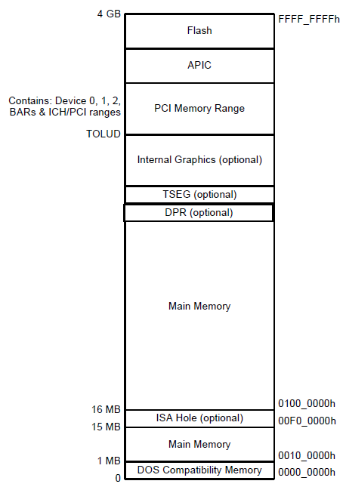
Memory Map
TOM
FFFF_0000
But on startup the processor is only aware of one memory range as we’ve seen
Often called the Boot Block, it contains the entry vector and uncompressed BIOS code
The system automatically maps the top 16 MB of memory to the flash bios
Non-negotiable, does not matter if your system has < 4 GB of memory, the system never actually accesses that memory. Rather, it is mapped to the flash device.
The rest of system memory needs to be configured by the BIOS

Slide 6
Hardware Block Diagram
FFFF_FFFFh
Chipset
DRAM Controller | B0:D0:F0
FEDA_0000h
Offset | Name | Value
48h | MCHBAR | FEDA0000h
F800_0000h
DRAM Controller | B0:D0:F0
Offset | Name | Value
60h | PCIEXBAR | F8000000h
0000_0000h
On the Mobile 4-Series Chipset, the BIOS (executed by the CPU), configures the MCHBAR in the DRAM Controller
FEDA_0000h (on an E6400 with 4GB RAM for example)
MCHBAR is now added to the memory map
So how does this actually occur?

